Slide 1

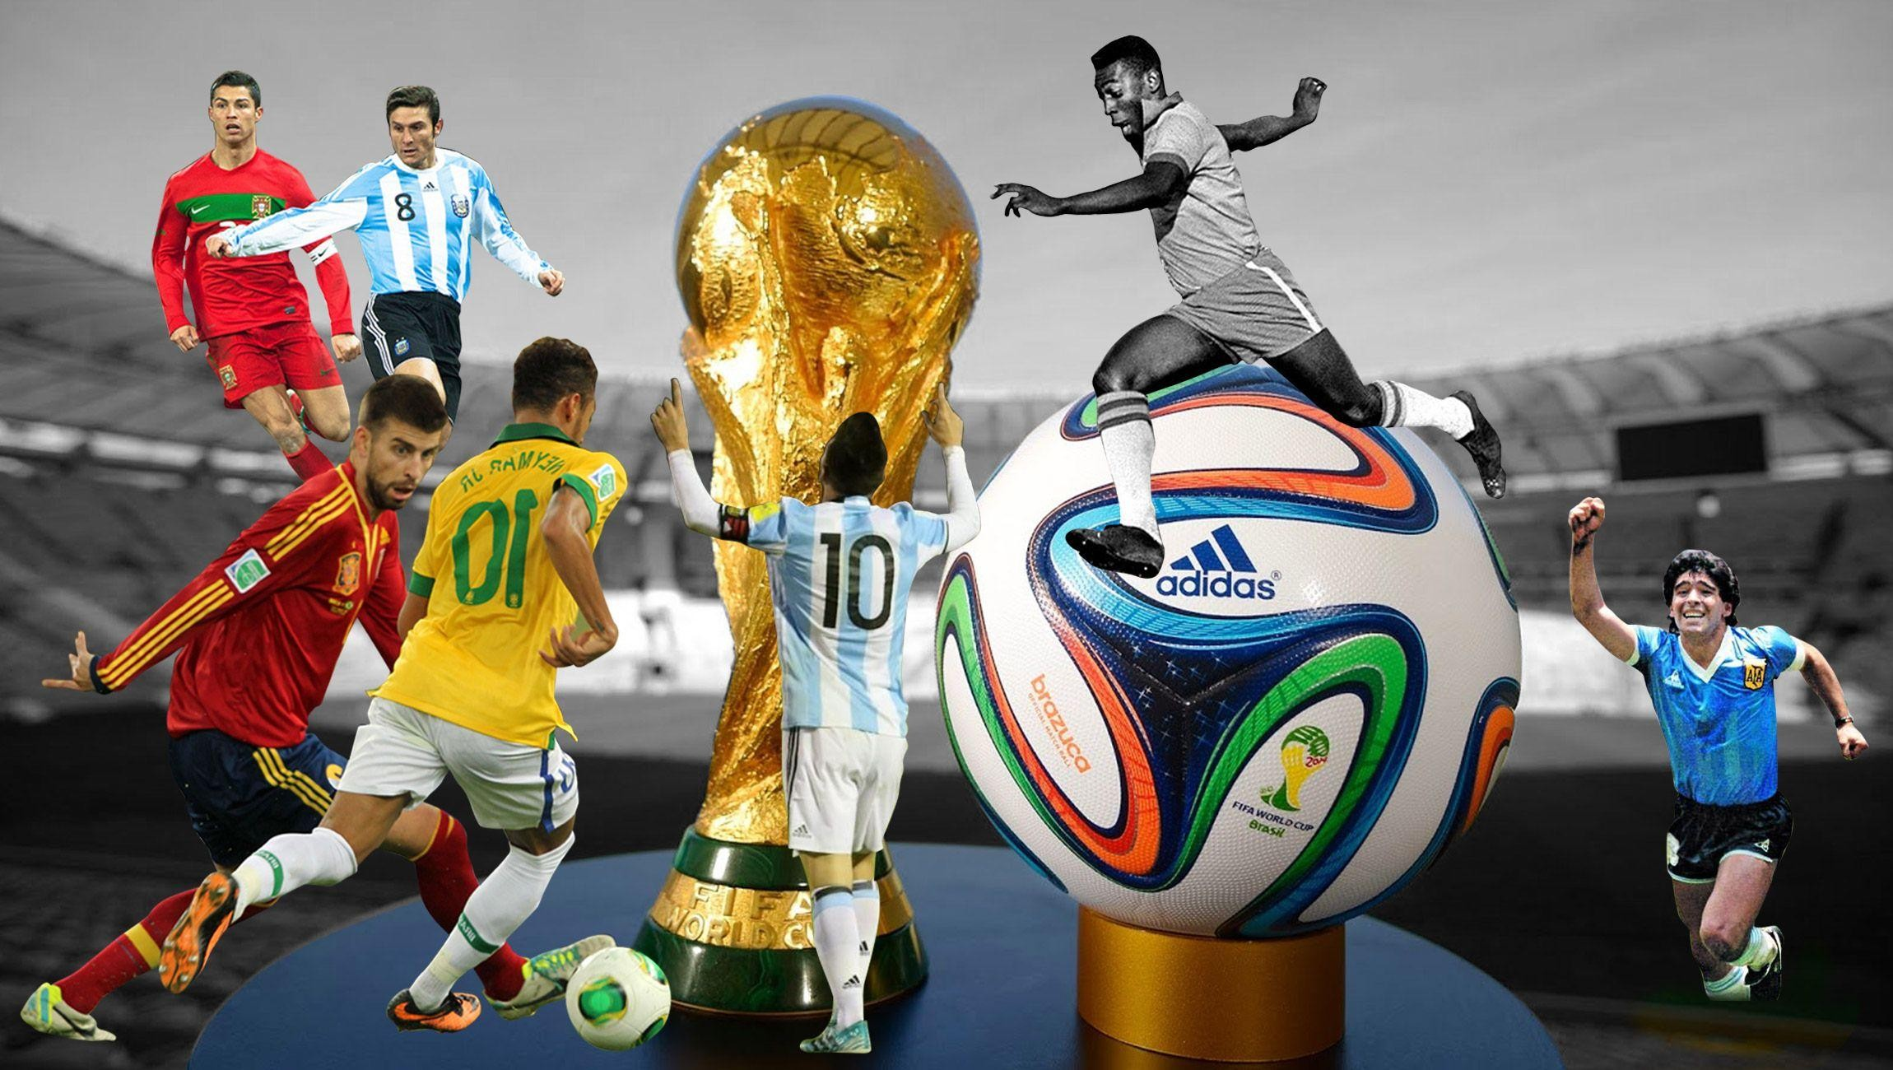

Slide 2

Technology Domain Difficulty Language Solution
Data Science
Sports
Advance
Exploratory Data Analysis using Python
GitHub Link and Tableau Public Link

Slide 3

With FIFA being in the blood as many people of the world. You are tasked to tell the story of unsung analysts who put great efforts to provide accurate data to answer every question of fans.
The FIFA World Cup is a global football competition contested by the various football-playing nations of the world. It is contested every four years and is the most prestigious and important trophy in the sport of football.
The World Cups dataset show all information about all the World Cups in the history, while the World Cup Matches dataset shows all the results from the matches contested as part of the cups.
Find key metrics and factors that influence the World Cup win.
Do your own research and come up with your findings.

Slide 4


To get useful insights from the FIFA WORLD CUP dataset and visualize to give some interesting figures to the football fans .
This project is based on FIFA World Cup Analysis to get insights about the Matches, patterns about players, Patterns about cup holders, Home Ground Advantage and many more things**

Slide 5

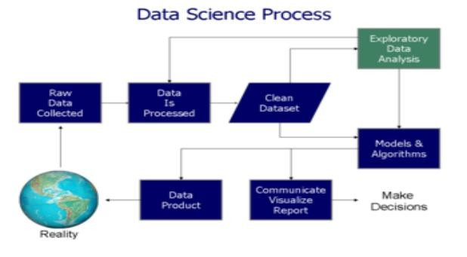

Slide 6
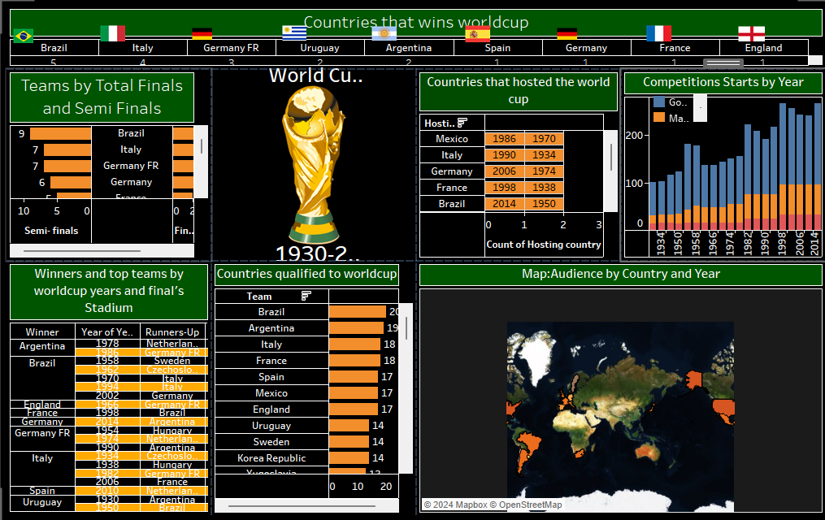

Slide 7
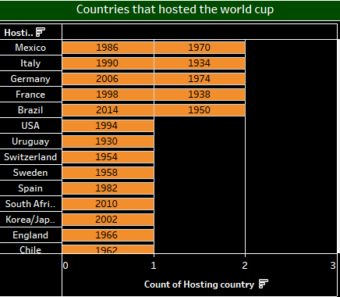

Slide 8
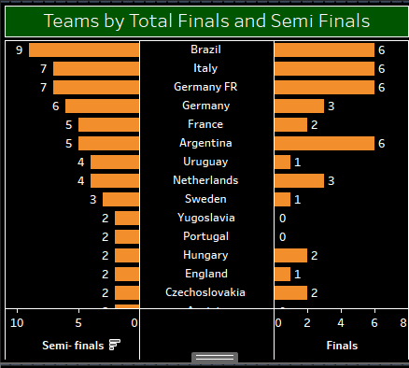

Slide 9


Most Number of World Cup Winning Title
Number of Goal Per Country
Attendance, Number of Teams, Goals, and Matches per Cup
Goals Per Team Per World Cup
Matches With Highest Number Of Attendance
Stadium with Highest Average Attendance
Which countries had won the cup ?
Number of goal per country
Match outcome by home and away teams

Slide 10

Q1) What is the source of data?
ANS - This dataset is publicly available for research. Available in the form of Jovian link –
pdf –
GitHub Link – Tableau Link –
Title = (FIFA World Cup Analysis )
Q 2) What was the type of data?
ANS - The data was contained in the zip folder in csv format.
Q 3) What steps should I follow to get insights from the data?
Step1 –Download the data and store it in a location in your PC.
Step2 –Open .ipynbsolution notebook, enter the path and run all cells.
Q 4) What were the libraries that you used in Python?
ANS - I used Pandas, NumPy, Matplotlib , Seaborn libraries in Python.

